Slide 1
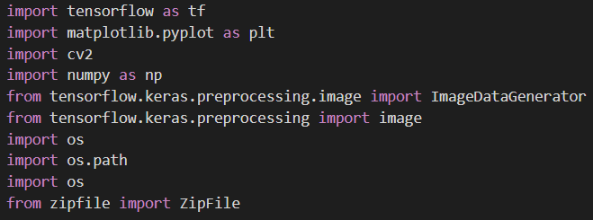
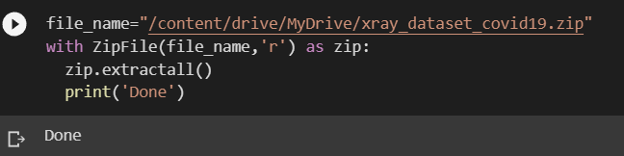
1.
We started from importing some liberies fropm tensorflow,matplotlib and opencv so on. And we are keeping dataset in my drive. so it was zip file, to open it we have to unzip. So there is a code to unzip here.

Slide 2
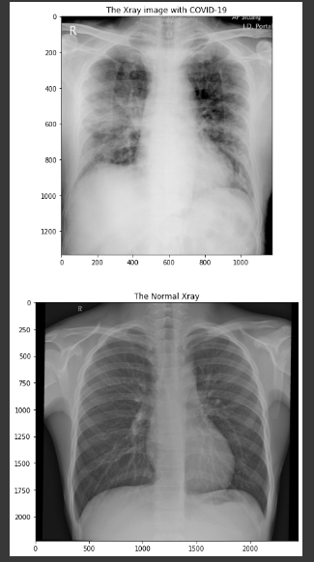
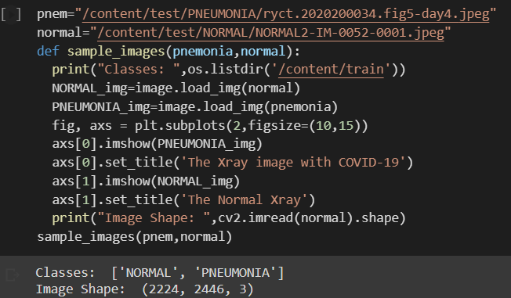
Then we decided to write a function to print out some samples from each class of images. We used load_img to print image. Then we used subplots to print it in one place. And we printed its shape as well you may check there.

Slide 3
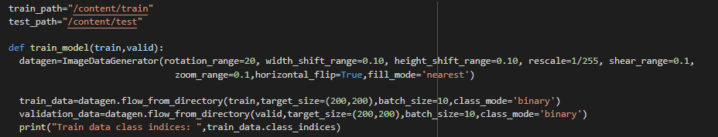
The next cell is a function which does the training. It has lots of things inside. Firstly we will give datagen as image generater. It is called data augmontation. So we shift, scale, rotate in certain numbers and it prints out images a lot according to the batch size. So if batch size=18, so it prints out 18 images for one image. Itbis really good for data sorting and getting different data. It is done in CNN usually for colorful images.Then we give links to that datagen. It takes the link and prints out images from the existing images.
Then we will build our model with sequential API. It is CNN, so we will have some convolutional layers and some poolings after it. Each has different karnel size and paddings. Then it gives the pooled images to flatten so it makes it as a list. It will ten goes to dense layers with is linear regression. It will have some neurons and drop outs to cut some weights there. We used 0.25 for dropout of weights. Then we will compile it to give optimizer and loss and the metrics type.
The next line is to fit the model. We connect the model to our preprocessed data. And We give some epochs to train.

Slide 4
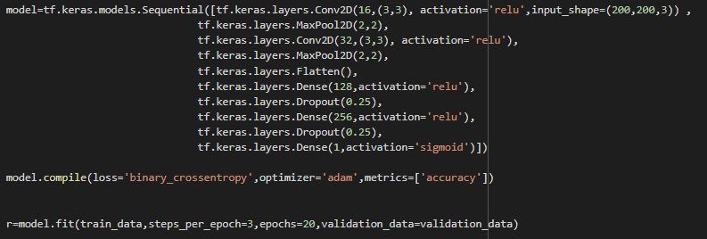
Then we
Here, we used sigmoid at the end, so it is binary. That is why it should be sigmoid function.

Slide 5
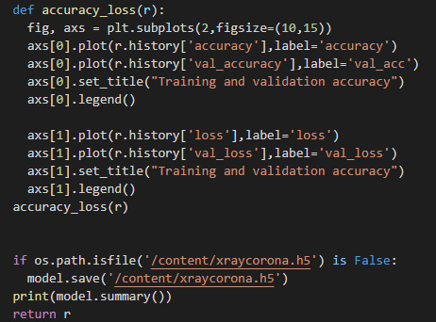
Once training is done we may see the plots for accuracy and losses. It is written with subplots. Then We saved the model as h5. It saves the model with all weights. Here it is.

Slide 6
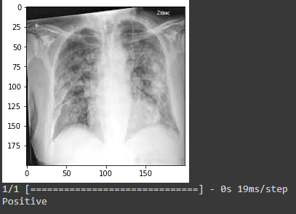
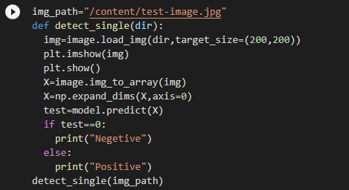
Testing is done as converting image to array. Then we correct the dimensions. We just give if else statement to see how is near to certain classes.You may detect with many images and one image. Please do not hesitate to test. We got really good accuracy. It comes with every epoch result.

